Slide 1
Capstone Project
Analysis of Facebook Followers Feedback Data
Zhiping Wang
3/2/2021

Slide 2
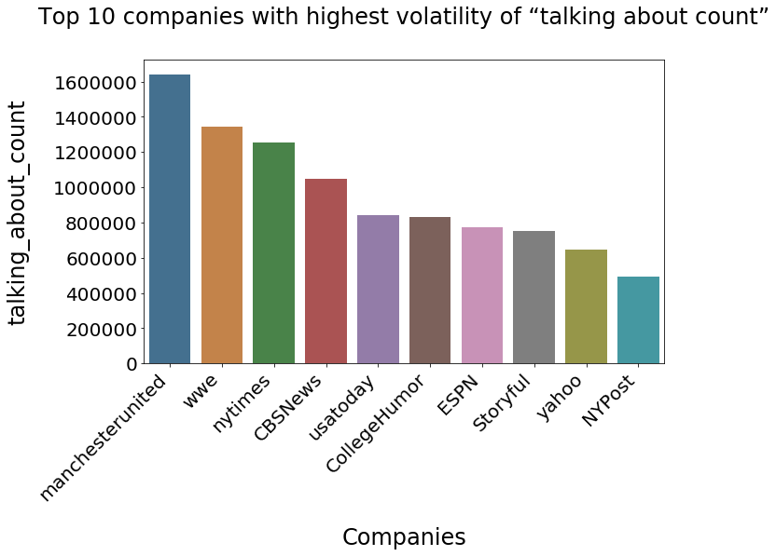
The top 10 companies with the highest volatility of ‘talking about count’
are: football club, media companies and online social media agency

Slide 3
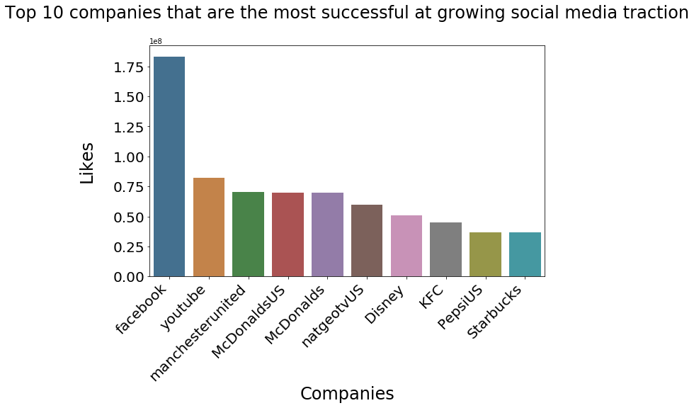
The winners that are the most successful at growing social media tractions are online platforms like Facebook
and youtube, fast food restaurants like McDonalds and KFC, football clubs and television network.

Slide 4
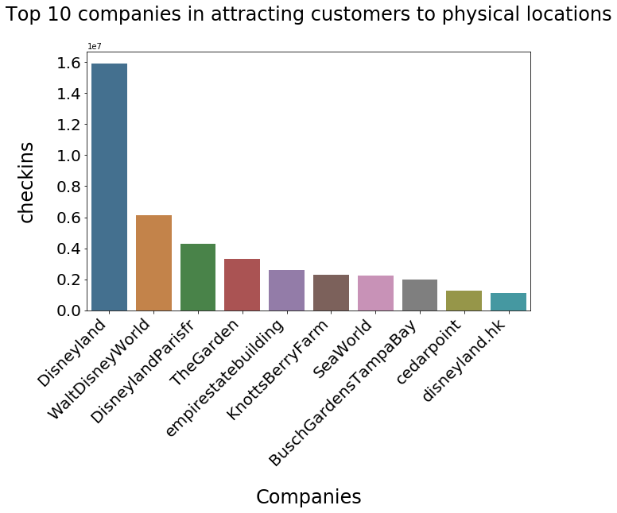

Slide 5
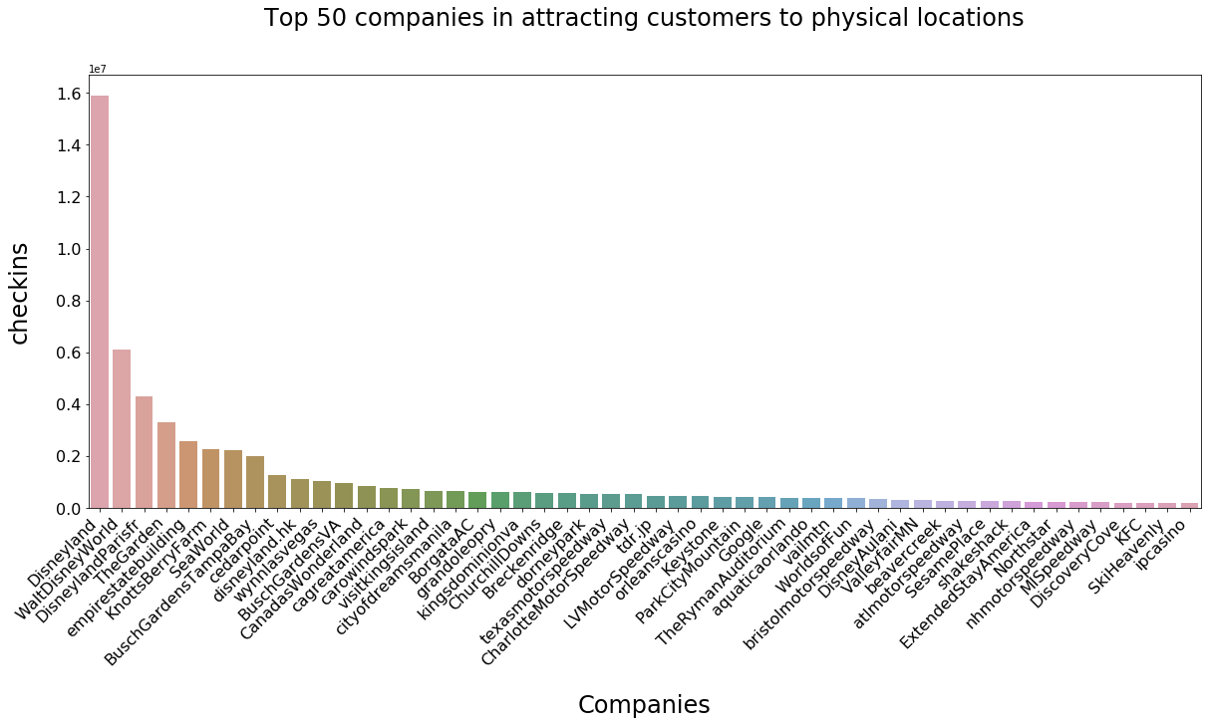
When using Facebook checkins data as a metrics for foot traffic for restaurant, hospitality and retail business, the winners are: Shakeshack, KFC, and theme parks such as Disneyland and xxx_ a_retail business.

Slide 6
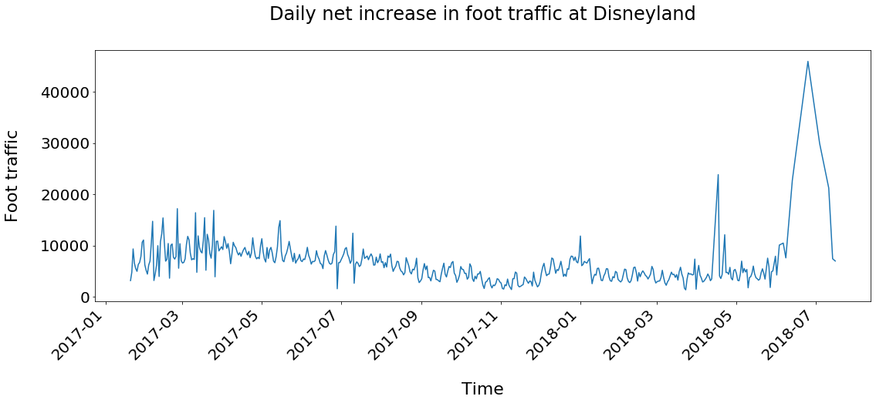
Time Series Forecasting
Daily foot traffic at Disneyland

Slide 7
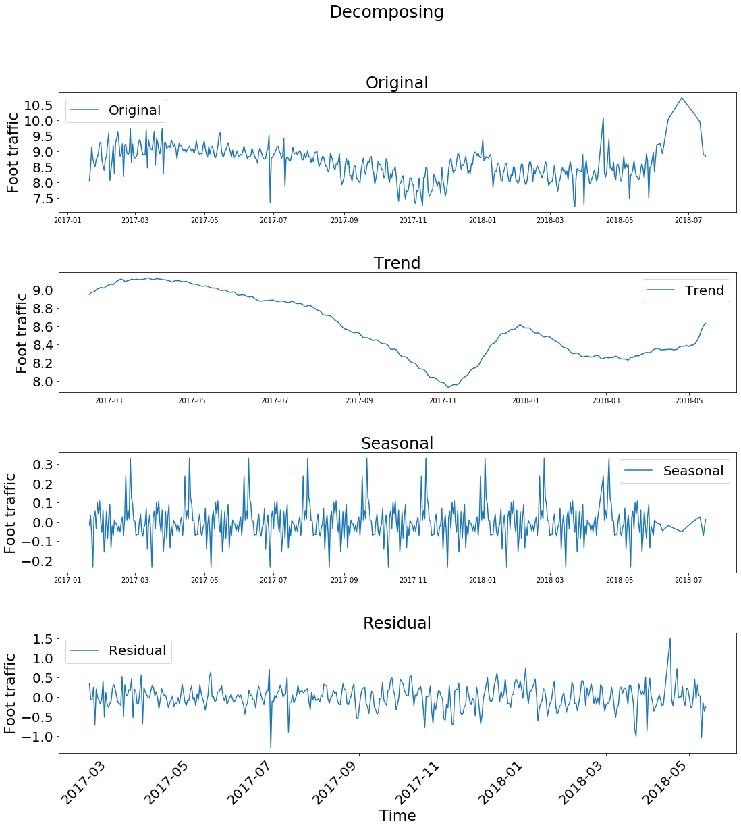

Slide 8
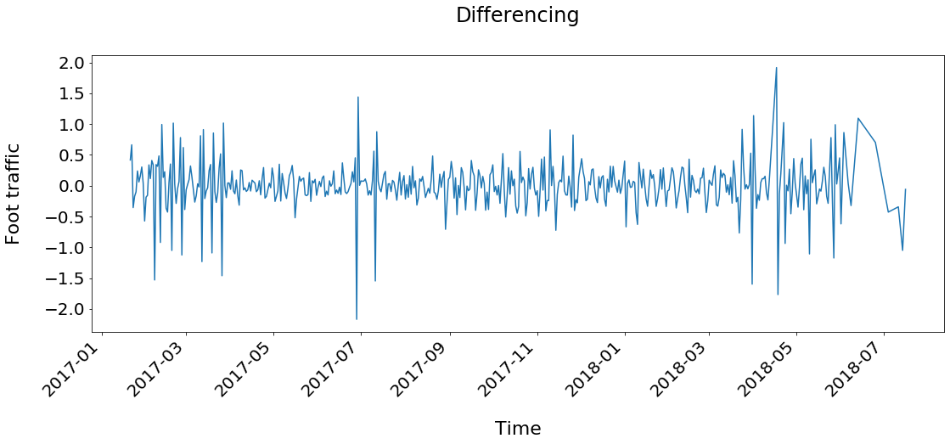

Slide 9
